Slide 1
Game Design and Programming
Neil Gannon

Slide 2
Today
Arrays
How to create one
How to use one (Updating Elements, Retrieving Elements)
Basic Inventory
How to define a basic inventory/pickup system
How to store an item
How to count the number of items we have
How to draw it

Slide 3
Arrays

Slide 4
Array
0
1
2
3
Arrays are a fixed size collection of elements
Arrays have an element type
The type of object that they can store
Elements in an array can be accessed using an index
An array of 10 elements
An index between 0 and 9
Different types of arrays
1 dimensional (1 index to access elements)
2 dimensional (2 indexes to access elements)
3+ dimensional
X Axis
0,0
1,0
2,0
Y Axis
0,1
1,1
2,1
0,2
1,2
2,2

Slide 5


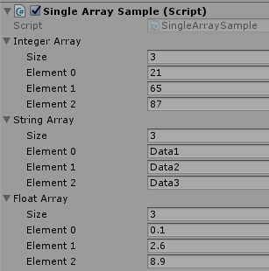
1D Array Creation
When creating an array we need to know
The type of data to be stored
How many we want to store
Arrays are declared using square brackets after the data type
int[], string[], float[]
To instantiate an array
Provide the size of the array inside the square brackets
Provide some starting data

Slide 6
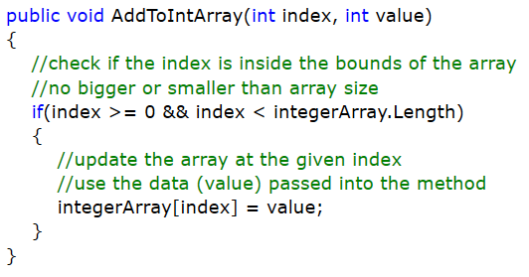
Updating Elements in an Array
Updating an element in an array requires two things
The index of the element we want to update
The value we want to update to
Good practice to check the index before attempting to use it
Ensure that index is within the bounds of the array
Greater than or equal to 0
Less than the length

Slide 7
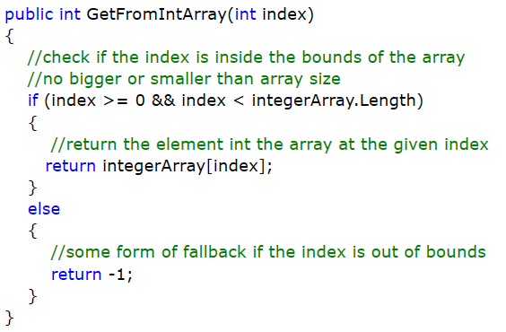
Retrieving Data from an Array
Reading an element from an array requires one thing
The index of the element we want to update
Again good practice to check the index before attempting to use it

Slide 8

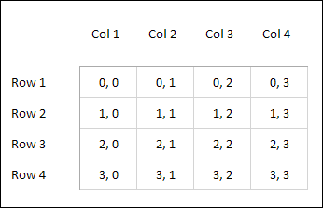
2D Array
You define the 2D Array by setting its integer width and height, which then sets the total number of "cells" within the grid
Rows and Columns
These cells are then used to hold different data values
To Update/Read an element we need two indexes
Can only store one data type
Everything in the array must be the same type (int, float, double, custom type)

Slide 9
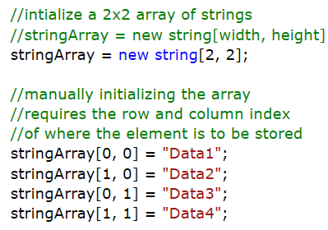
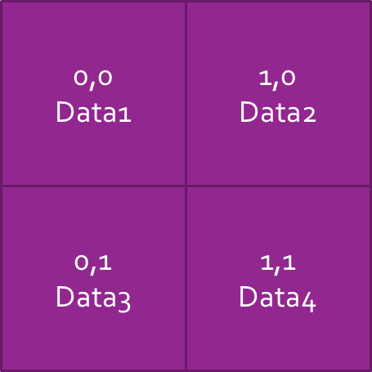
2D Array Creation
When creating a 2D array we need to know
The type of data to be stored
How many we want to store
Arrays are declared using square brackets after the data type
Addition of a comma for each dimension of the array
int[,], string[,], float[,]
To instantiate a 2D array
Provide the width and height of the array inside the square brackets
Provide some starting data

Slide 10
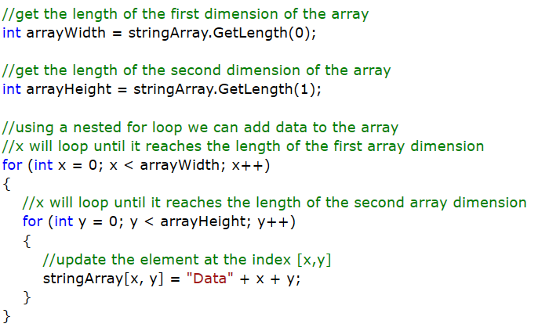
2D Array Creation (Alternative)

Slide 11
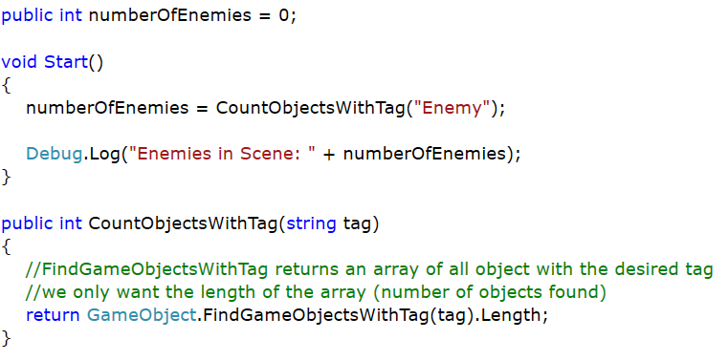
Using Arrays for Counting Objects
Unity provides a way to get all objects with a specific tag
This method returns an array of game objects
Every array has a length property with the number of elements in it

Slide 12
Inventory

Slide 13
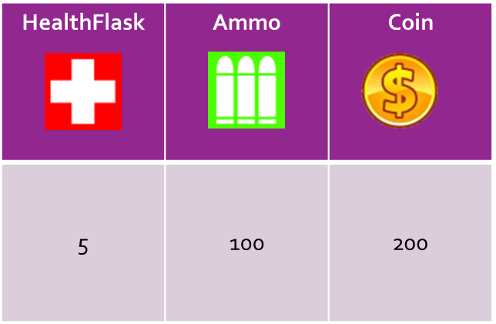

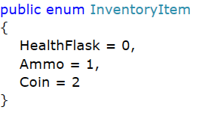
Array for an Inventory
We want to store the number of inventory items a player has in a single array
This will be 1D array
All inventory items are defined as an Enum
Remember these are fixed an cannot change as the application runs
Named integer list
We are going to use the Enum to act as the index to access/update elements in the inventory array

Slide 14
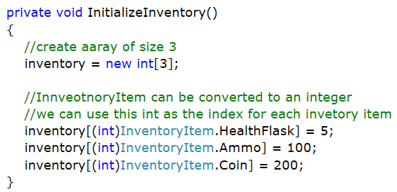
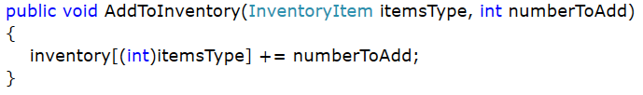
Creating the Inventory
We store the inventory in an array
Size of three
We creating the array
Use the Enum as the index (converted to an int)
Assign some starting values
When working with this array
Need only know the InventoryItem enum that we want to use

Slide 15
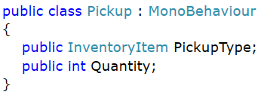
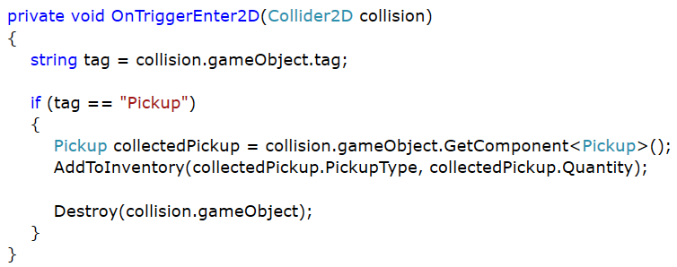
Handling Collision with Pickups
Every object that the player can pick up will use the Pickup script
Type of pickup (InventoryItem)
Quantity (int)
When we collide with an object tagged as pickup
Get the Pickup script from the object
Use the PcikupType as the index
Use Quantity as the number to add to the existing count
Destroy the pickup

Slide 16
Drawing the Inventory

Slide 17

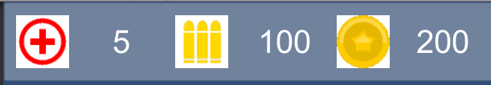
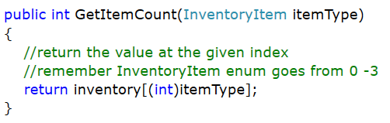
Drawing the Inventory
To create the inventory UI
Three Images and Three Text
A UIController script for reading values form the player inventory
Update the text with the umber of each inventory item
Continually do this in the Update of the UIController

Slide 18
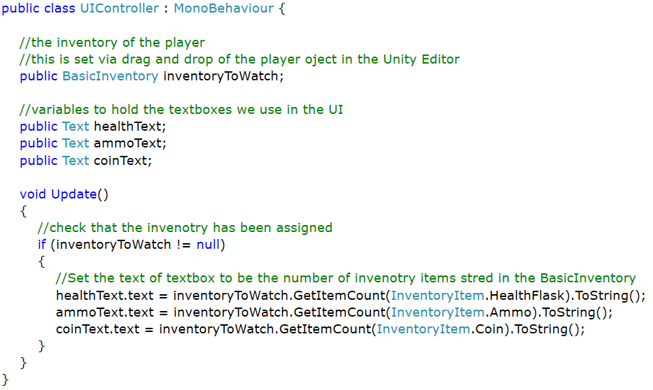
Drawing the Inventory
BasicInventory contains an array of ints
We are using InventoryItem as the index to access elements
The BasicInventory has a method called GetItemCount
Calling this returns an int with the number of items
Update the text with this number

Slide 19
Project

Slide 20
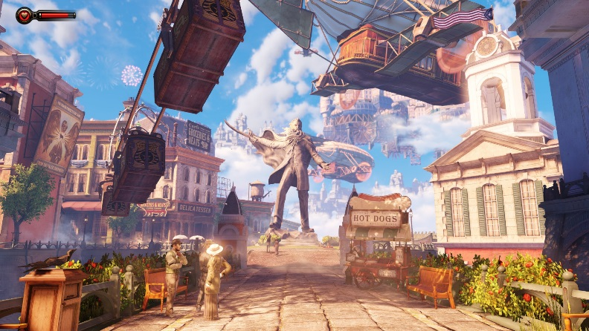
Components of a Game
Story
Game Style
Gameplay
Content
Code
Platforms
Engines
Tools
Testing
Bioshock Infinite (2013)

Slide 21
Game Development Roles
The roles involved in development can be broken into two categories
Coding
Gameplay Developers
Engine Developers
Tools Developers
Quality Assurance
Non-Coding
Writers
Game Designers
Level Designers
Artists
Producers
Testers

Slide 22
Development Roles Graph
Game
Designer
Tester
QA
Game
Developer
Tool
Developer
Engine
Developer

Slide 23
Area | Marks | 1 | 2 | 3
Design and Art | 30 | Default assets have been used with no modifications or additions. | Some default assets are being used but there are custom assets for everything else. The player is still using vlad but most other sprites are custom. | The majority of assets have been replaced with custom ones. The team has created their own set of sprites.
Code | 30 | There is no code or functionality beyond the default given. | Project is built upon a starter kit but contains a range of new custom functionality. | Project is not built on a starter kit and is entirely custom. There may be some code from online sources but only minimal.
Understanding (report) | 10 | Demonstrated no understanding of what they have built or how it works. No new features/objects have been added. | Room is built upon another team members work but additional features/objects are present. Member understands how the core of the game works. | Demonstrated a deep understanding of the project and how it was implemented. The room adds new features/objects not found in other rooms.
Group | 10 | The team appears to not have worked together at all. | The team has worked together to create a base game that each member has built on. The project would suggest that each member has worked independently from each other without working towards a common goal. | The team have worked closely throughout the semester and the project reflects a tight integration of code and content.
Gameplay | 20 | There is no gameplay beyond the default | Basic gameplay elements that have not moved beyond projects/samples given over the past 2 semesters. | The game features multiple gameplay elements that interact and feed into each other.

